Slide 1


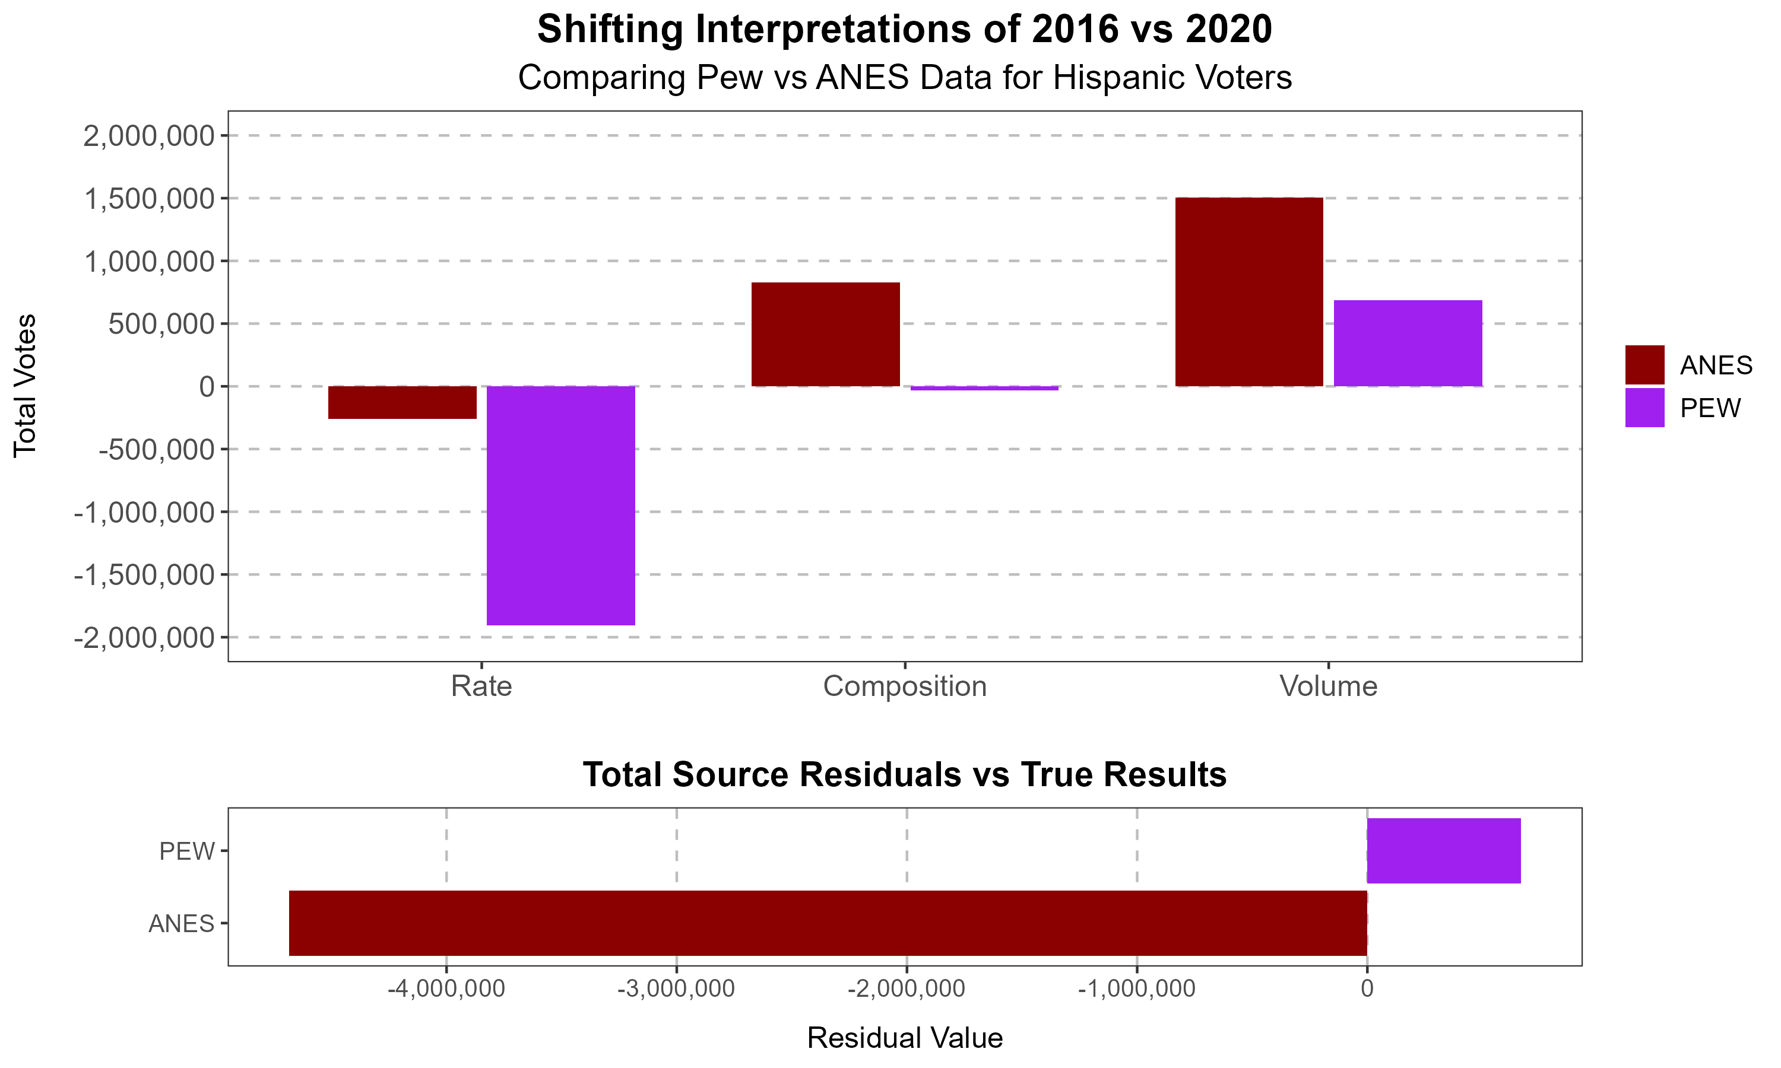
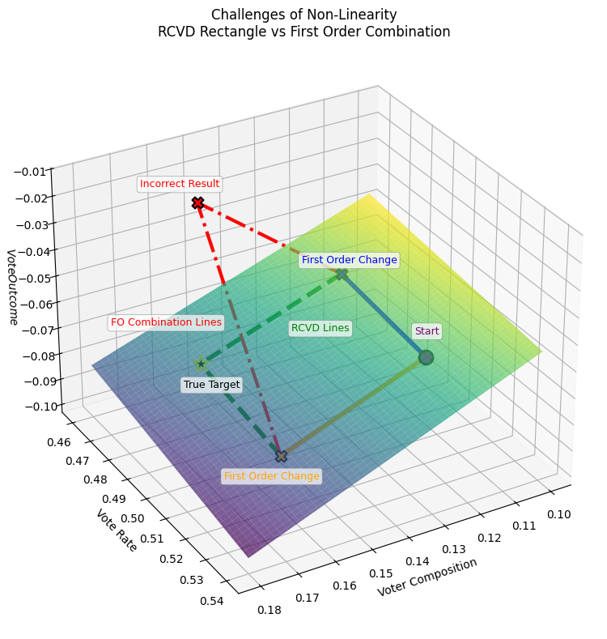
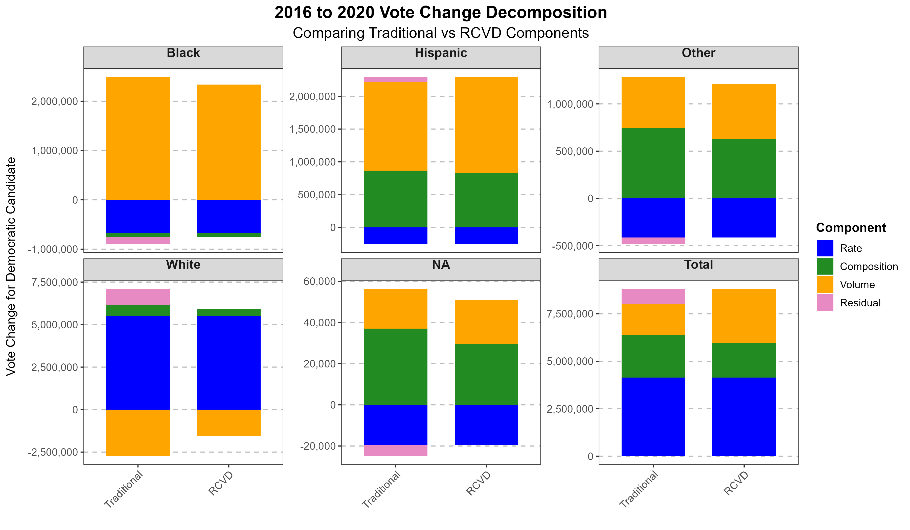

The Rate, Composition, and Volume Decomposition Method:
A Zero-Loss Approach to Decomposing Electoral and Compositional Shifts
Donald Moratz
dmoratz@sas.upenn.edu
Abstract
The RCVD Method
RCVD in Action: U.S. Elections
Existing methods for decomposing electoral change (e.g., derivative-based, regression) often fail to fully account for total vote shifts and complex compositional dynamics due to their inability to capture cross-partial derivatives. This work introduces the Rate, Composition, and Volume Decomposition (RCVD), a novel, zero-loss approach that precisely quantifies within-group and cross-group compositional changes. RCVD offers a more accurate, interpretable, and consistent framework for analyzing electoral outcomes.
The RCVD method accurately decomposes total vote change (ΔZ) into distinct, interpretable components:
Rate ($r_{t}$): Group's vote choice percentage at time t
Composition ($c_{t}$): Group’s share of the electorate at time t
Volume ($v_{t}$): Total electorate size at time t
Votes ($Z_{t}$): Total votes a group gives to a candidate at time t, $Z_{t}=r_{t}c_{t}v_{t}$
The RCV approach is a zero-loss, non-linear solution that ensures the sum of decomposed changes equals the total observed change (ΔZ = ΔR + ΔC + ΔV). It explicitly accounts for complex sequential interactions between these components.
Core Principle: ΔZ = $Z_{t+1}$ - $Z_{t}$
Applying RCVD to the 2016 and 2020 U.S. presidential elections reveals critical insights often missed by other methods:
Data Validation: RCVD can expose inconsistencies or errors in underlying survey data (e.g., differences between ANES vs. PEW estimates), allowing researchers to identify data quality issues before drawing conclusions
Hispanic Vote Shift: RCVD analysis accurately highlighted a significant shift in support among Hispanic voters, which was a key factor in the 2020 results and provided prescient insights for 2024. This supports the findings of Fraga et al. (2024), though they use traditional methods.
This provides a robust framework for understanding nuanced electoral dynamics that are crucial for contemporary political analysis.
Problem With Existing Approaches
Traditional methods, such as the derivative-based approach, conflate composition and volume effects. Critically, both derivative-based and regression models fail to capture the interactive effects (cross-partial derivatives) between rate, composition, and volume changes. Traditional approaches often treat these as independent, missing crucial interaction terms. This leads to:
Inaccurate accounting for total vote shifts.
Misrepresentation of individual component contributions (rate, composition, volume).
Biased estimations that can overstate or understate actual electoral dynamics.
Significant progress has been made on this problem by Marble et al. (2024), but RCVD addresses the remaining residual.
$$\text{Key} \text{Equation}$$
$$∆Z= \left[r_{t+1}−r_{t}\right]c_{t}v_{t}+r_{t+1}\left[c_{t+1}−c_{t}\right]v_{t}+r_{t+1}c_{t+1}[v_{t+1}−v_{t}]$$
First move rate, holding composition and volume constant
Composition
Using the new rate, move composition, holding volume constant
Volume
Finally, using the new rate and composition, move volume
Rate
RCVD in Action: U.S. Elections
US Election Data demonstrates RCVD's superior accuracy. Unlike traditional methods, RCVD consistently:
Produces perfectly additive decompositions, ensuring zero-loss.
Correctly attributes changes to their respective Rate, Composition, and Volume components, even under complex, interacting scenarios.
Exposes how reliance on other methods can lead to biased estimations of electoral shifts, particularly when group sizes and voting patterns change simultaneously.
Conclusion & Implications
The RCVD Method provides a mathematically rigorous and practically valuable tool for political scientists. It offers:
Unparalleled Accuracy: Zero-loss decomposition for comprehensive electoral change analysis.
Enhanced Interpretability: Clear, distinct contributions of Rate, Composition, and Volume shifts.
Robust Data Evaluation: A framework for identifying data inconsistencies.
Improved Predictive Power: Better understanding of underlying trends for future electoral outcomes.
RCVD is essential for advancing our understanding of demographic and electoral change in modern political science.
This 3D graph illustrates how neglecting cross-partial derivatives, even with only two interacting components, leads to significant miscalculations in the overall change. The First-Order Line deviates from the RCVD Line and True Target, demonstrating the accurate decomposition provided by RCVD. This issue is compounded when considering three components (Rate, Composition, Volume).
Key References
Marble, William, Justin Grimmer, and Cole Tanigawa-Lau (Sept. 2024). “Measuring the Contribution of Voting Blocs to Election Outcomes”. en. In: The Journal of Politics, p. 732964. issn: 0022-3816, 1468-2508.
Fraga, Bernard L., Yamil R. Velez, and Emily A. West (May 2024). “Reversion to the Mean, or Their Version of the Dream? Latino Voting in an Age of Populism”. en. In: American Political Science Review, pp. 1–9. issn: 0003-0554, 1537-5943.
Hartig, Hannah et al. (July 2023). Republican Gains in 2022 Midterms Driven Mostly by Turnout Advantage. Tech. rep. Pew Research Center.

